Slide 1
KDD (Knowledge Discovery in Databases)
CSE5072 – Data Mining and Knowledge Discovery

Slide 2

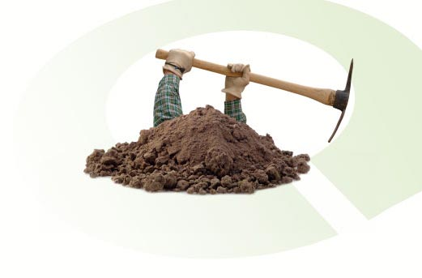
Outline
Knowledge Discovery in Databases (KDD)
  Goal Identification
  Data Preparation
    Data Integration
    Data Selection
    Data Preprocessing
    Data Transformation
  Data Mining
  Presentation and Evaluation

Slide 3
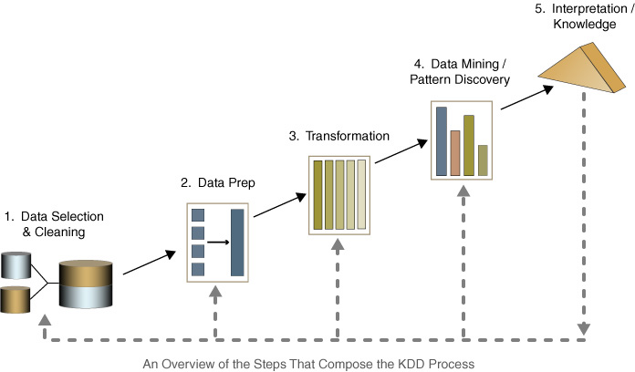
Knowledge Discovery in Databases (KDD)
Knowledge Discovery Process includes many iterative steps:
  Goal Identification
  Data Preparation
    Data Integration
    Data Selection
    Data Preprocessing
    Data Transformation
  Data Mining
  Presentation and Evaluation
Presentation
Data Integration
Goal Identification

Slide 4
Knowledge Discovery Process
Goal Identification
  Application Domain Understanding
    Determine data mining objective
    Determine success criteria
    Inventory resources
    Constraints
    Cost and benefits
  Data Understanding
    Describe data
Presentation
Data Integration
Goal Identification

Slide 5
Knowledge Discovery Process
Data Preparation
  Data Integration
  Data Selection
  Data Preprocessing
  Data Transformation
Presentation
Data Preparation
Data Integration
Goal Identification

Slide 6
Knowledge Discovery Process
Data Integration
  Obtain and collect data from various sources
    Exp: Outside or inside of the company
  Combine data from multiple sources into a coherent store
    Tables
      Excel Tables
      Database Tables (Access, SQL Server, Oracle ... )
    Files (unstructured or structured files)
      XML Files
    Web Pages
    Data Cubes
    Data Marts
Presentation
Data Integration
Goal Identification

Slide 7
Knowledge Discovery Process
Data Integration
Possible Problems:
  Same person, different spellings
    e.g. Agarwal, Agrawal, Aggarwal ...
  Multiple ways to denote company name
    e.g. Persistent Systems, PSPL, Persistent Pvt. LTD.
  Different metrics
    e.g., cm³ m³
  Schema errors
    e.g., A.cust-id ≡ B.cust-#
Presentation
Data Integration
Goal Identification

Slide 8
Knowledge Discovery Process
Data Selection
  Database may store terabytes of data
    Complex data analysis / mining
    May take a very long time to run on the complete data set
  Selecting a target dataset
  Obtains a reduced representation of the data set
  (smaller in volume but yet produces the same (or almost the same) results)
Presentation
Data Integration
Goal Identification

Slide 9

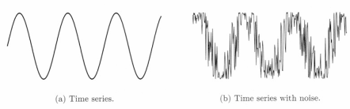
Knowledge Discovery Process
Data Preprocessing
  Data in the real world is dirty
    incomplete: lacking attribute values or containing only aggregate data
    noisy: containing errors or outliers
    inconsistent: containing discrepancies in codes or names
  Preprocessing :
    Fill in missing values
    Remove noisy data
    Identify and remove outliers
    Resolve inconsistencies
    Remove duplicate data
Presentation
Data Integration
Goal Identification

Slide 10
Knowledge Discovery Process
Data Transformation
  Convert data into common format
  Attribute / feature construction
    New attributes constructed from the given ones
  Discretization
  Aggregation
  Normalization
Presentation
Data Integration
Goal Identification

Slide 11
Knowledge Discovery Process
Data Mining
  Data Mining is a step in the KDD process.
  Selection of a data mining algorithm or tool according to the data mining objective
    Choosing data mining algorithm
      Classification (CHAID, C4.5, ...)
      Clustering (K-Means, K-Medoid, DBSCAN, COBWEB, BIRCH, STING, ...)
      Association Rule Mining (Apriori, Fp-Growth, ...)
      ...
    Choosing a data mining tool
      MS SQL Analysis Service
      Oracle Data Miner
      IBM – SPSS Clementine
      ...
Presentation
Data Integration
Goal Identification

Slide 12
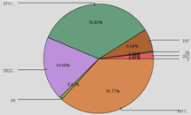
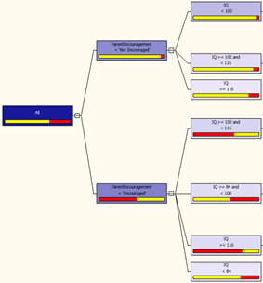
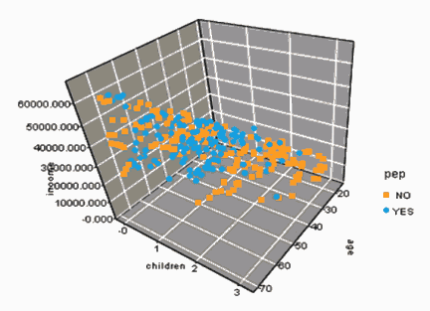
Knowledge Discovery Process
Presentation and Evaluation
  Presentation of data mining results:
    Visualization: using graphical methods to show patterns
  Evaluation of data mining results:
    Identifying interesting or useful patterns
    Analyze the results
      How well it performed on test data
      Important or not
      Who needs to use them?
Presentation
Data Integration
Goal Identification

Slide 13
Knowledge Discovery Process (Summary)
Goal Identification: Determine the objectives and understand data
Data Preparation
  Data Integration: Obtain data from various sources
  Data Selection: Select target data
  Data Preprocessing: Clean data
  Data Transformation: Convert to common format (Transform to new format)
Data Mining: Obtain desired results
Evaluation and Presentation: Evaluate and present the data mining results
Presentation
Data Integration
Goal Identification

Slide 14
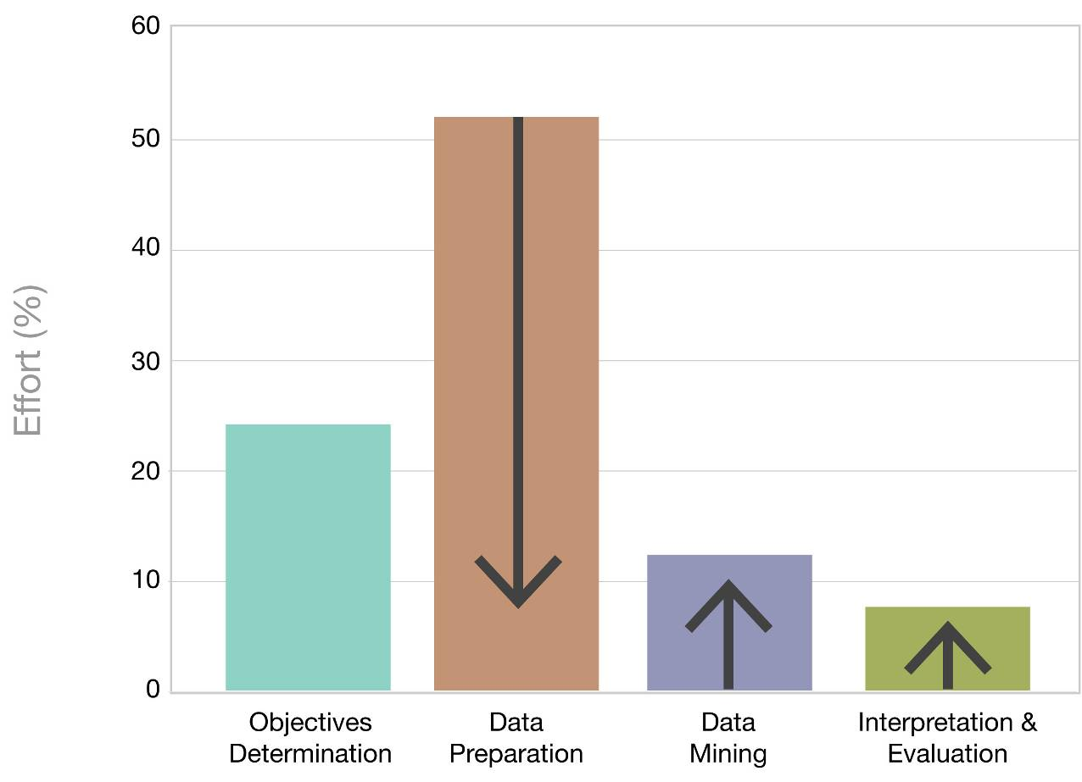
Required effort for each KDD Step
  Data preparation may take 50-55% of effort !
Arrows indicate the direction we hope the effort should go.

Slide 15
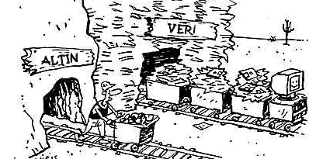
Data Mining

Slide 16
Slides are acknowledged from:
Asst. Prof. Dr. Derya BİRANT

